Slide 1
Financial Markets and Securities Session 1 Asset Classes and Financial Instruments

Slide 2
The Investment Environment

Slide 3
Investments & Financial Assets
Essential nature of investment
Reduced current consumption
Planned later consumption
Real Assets
Assets used to produce goods and services (land, building, machine, knowlegde)
Financial Assets
Claims on real assets or income generated by them (stocks, bonds)

Slide 4
Financial Assets
Fixed income or debt
Promise either a fixed stream of income or a stream of income determined by a specified formula
Common stock or equity
Represent an ownership share in the corporation
Derivative securities
Provide payoffs that are determined by the prices of other assets

Slide 5
Other Types of Investment
Investment in currency
Investment in real assets through commodity futures
Corporations invest in the commodity futures to hedge the risk

Slide 6
Financial Markets and the Economy
The Informational Role
Capital flows to companies with best prospects
Consumption Timing
Use securities to store wealth and transfer consumption to the future
Allocation of Risk
Investors can select securities consistent with their tastes for risk, which benefits the firms that need to raise capital as security can be sold for the best possible price

Slide 7
The Investment Process
Portfolio: Collection of investment assets.
Asset allocation
Choice among broad asset classes
Security selection
Choice of securities within each asset class

Slide 8
The Investment Process
“Top-down” approach
Asset allocation followed by security analysis to evaluate which particular securities to be included in the portfolio
“Bottom-up” approach
Investment based solely on the price-attractiveness, which may result in unintended heavy weight of a portfolio in only one or another sector of the economy

Slide 9
Markets Are Competitive
Risk-Return Trade-Off
Higher-risk assets are priced to offer higher expected returns than lower-risk assets
Efficient Markets
In fully efficient markets when prices quickly adjust to all relevant information, there should be neither underpriced nor overpriced securities

Slide 10
Markets Are Competitive
Passive Management
Holding a highly diversified portfolio
No attempt to find undervalued securities
No attempt to time the market
Active Management
Finding mispriced securities
Timing the market

Slide 11
Players of the Market
Demanders of capital – Firms
Suppliers of capital – Households
Governments – Can be both borrowers or lenders
Financial Intermediaries: Pool and invest funds
Investment Companies
Banks
Insurance companies
Credit unions

Slide 12
Financial Markets

Slide 13
Classes of Financial Markets
Money market
Bond market
Equity markets
Indexes
Derivative markets
Notes:
From low to high risk order

Slide 14
Money Market

Slide 15
Money Market Instruments
The Money Markets
The term “money market” is a misnomer. Money (currency) is not actually traded in the money markets.
Subsector of the fixed-income market. Highly liquid, and relatively low-risk debt instruments.
Usually sold in large denominations ($1,000,000 or more)
Low default risk
Mature in one year or less from their issue date, although most mature in less than 120 days
Purpose: Provides a place for warehousing surplus funds for short periods of time
Borrowers from money market provide low-cost source of temporary funds
Corporations and U.S. government use these markets because the timing of cash inflows and outflows are not well synchronized.
Money markets provide a way to solve these cash-timing problems.
Notes:
What is repo?
overnight borrowings between banks and other entities to maintain their bank reserves at the Federal Reserve. Banks keep reserves at Federal Reserve Banks to meet their reserve requirements and to clear financial transactions

Slide 16
The purpose of Money Markets
Why Do We Need Money Markets?
The banking industry should handle the needs for short-term.
Banks have an information advantage.
Banks, however, are heavily regulated.
Creates a distinct cost advantage for money markets over banks.
Investors in Money Market: Provides a place for warehousing surplus funds for short periods of time
Borrowers from money market provide low-cost source of temporary funds
Corporations and U.S. government use these markets because the timing of cash inflows and outflows are not well synchronized.
Money markets provide a way to solve these cash-timing problems.

Slide 17
Money Market Instruments
Treasury Bills
Federal Funds
Repurchase Agreements (REPO)
Negotiable Certificates of Deposit
Commercial Paper

Slide 18
Money Market Instruments
Treasury Bills
T-bills have 28-day maturities through 12- month maturities.
Discounting: When an investor pays less for the security than it will be worth when it matures, and the increase in price provides a return. This is common to short-term securities because they often mature before the issuer can mail out interest checks.
FED Funds:
Short-term funds transferred (loaned or borrowed) between financial institutions, usually for a period of one day.
Used by banks to meet short-term needs to meet reserve requirements.

Slide 19
Money Market Instruments
Repurchase Agreements (REPO):
These work similar to the market for fed funds, but nonbanks can participate.
A firm sells Treasury securities, but agrees to buy them back at a certain date (usually 3–14 days later) for a certain price.
This set-up makes a repo agreements essentially a short-term collateralized loan.
This is one market the Fed may use to conduct its monetary policy, whereby the Fed purchases/sells Treasury securities in the repo market.
Notes:
What is repo?
overnight borrowings between banks and other entities to maintain their bank reserves at the Federal Reserve. Banks keep reserves at Federal Reserve Banks to meet their reserve requirements and to clear financial transactions

Slide 20
Money Market Instruments
Commercial Paper:
Unsecured promissory notes, issued by corporations, that mature in no more than 270 days.
The use of commercial paper increased significantly in the early 1980s because of the rising cost of bank loans.
Risk of a particular commercial paper = risk of issuer company’s default risk
Notes:
What is repo?
overnight borrowings between banks and other entities to maintain their bank reserves at the Federal Reserve. Banks keep reserves at Federal Reserve Banks to meet their reserve requirements and to clear financial transactions

Slide 21
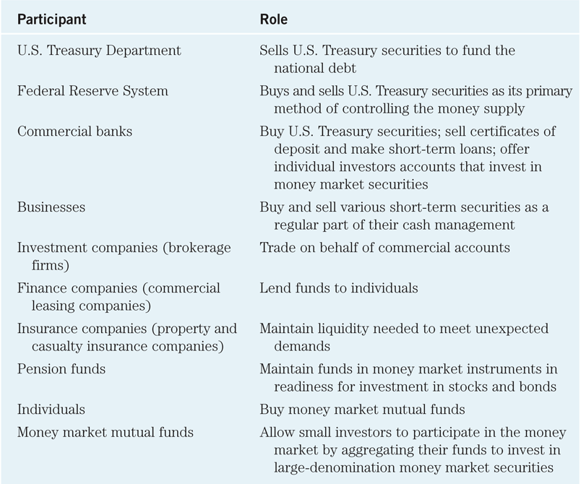
Participants in the Money Markets
Table 11.2 Money Market Participants

Slide 22
Certificates of Deposit
A bank-issued security that documents a deposit and specifies the interest rate and the maturity date
Denominations range from $100,000 to $10 million

Slide 23
Banker’s Acceptances
An order to pay a specified amount to the bearer on a given date if specified conditions have been met, usually delivery of promised goods.
These are often used when buyers / sellers of expensive goods live in different countries.
Exporter paid immediately
Exporter shielded from foreign exchange risk
Exporter does not have to assess the financial security of the importer
Importer’s bank guarantees payment
Crucial to international trade

Slide 24
Banker’s Acceptances
As seen, banker’s acceptances avoid the need to establish the credit-worthiness of a customer living abroad.
There is also an active secondary market for banker’s acceptances until they mature. The terms of note indicate that the bearer, whoever that is, will be paid upon maturity.

Slide 25
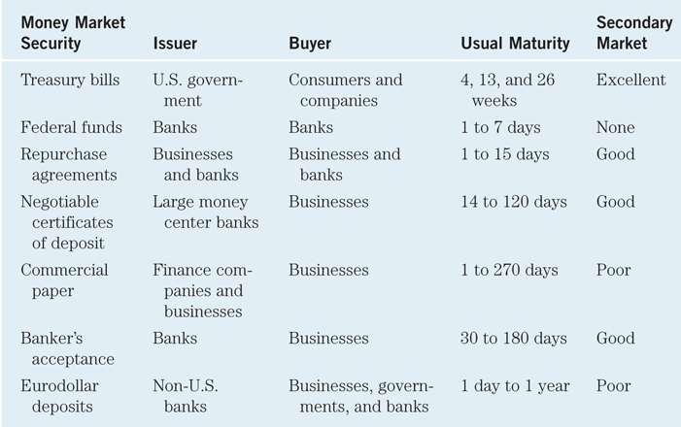
Comparing Money Market Securities
Table 11.4 Money Market Securities and Their Markets

Slide 26
The Bond Market

Slide 27
The Bond Market
Treasury Notes and Bonds
Inflation-Protected Treasury Bonds
Federal Agency Debt
International Bonds
Municipal Bonds
Corporate Bonds
Mortgages and Mortgage-Backed Securities

Slide 28
Bond Market Securities
Treasury Notes and Bonds
Maturities
Treasury bill – up to 1 year
Notes – Maturities up to 10 years
Bonds – Maturities from 10 to 30 years
Par Value - $1,000
Interest paid semiannually
Quotes – Percentage of par
113.5078% = $1,135.078

Slide 29
Bond Market Securities
Inflation-Protected Treasury Bonds
TIPS (Treasury Inflation-Protected Securities): Provide inflation protection
Federal Agency Debt
Debt of mortgage-related agencies such as Fannie Mae and Freddie Mac
International Bonds
Eurobonds and Yankee bonds and Samurai bonds
Notes:
A Eurobond is a bond denominated in a currency other than that of the country in which it is issued. For example, a dollar-denominated bond sold in Britain would be called a Eurodollar bond.
Similarly, investors might speak of Euroyen bonds, yen-denominated bonds sold outside Japan.
In contrast to bonds that are issued in foreign currencies, many firms issue bonds in foreign countries but in the currency of the investor. For example, a Yankee bond is a dollar- denominated bond sold in the United States by a non-U.S. issuer. Similarly, Samurai bonds are yen-denominated bonds sold in Japan by non-Japanese issuers.

Slide 30
Bond Market Securities
Municipal Bonds
Issued by state and local governments
Interest is exempt from federal income tax and sometimes from state and local tax
Types
General obligation bonds: Backed by taxing power of issuer
Revenue bonds: backed by project’s revenues or by the municipal agency operating the project.

Slide 31
Bond Market Securities
Corporate Bonds
Issued by private firms
Semi-annual interest payments
Subject to larger default risk than government securities
Options in corporate bonds
Callable
Convertible

Slide 32
The Stock Market

Slide 33
Investing in Stocks
Represents ownership in a firm
Earn a return in two ways
Price of the stock rises over time (Capital Gain)
Dividends are paid to the stockholder (Dividend Yield)
Stockholders have claim on all assets
Right to vote for eg. management board, strategy and acceptance of the financial statement
Two types
Common stock
Right to vote
Receive dividends
Preferred stock
Receive a fixed dividend
Do not usually vote

Slide 34
How Stocks are traded
Organized exchanges
NYSE is best known, with daily volume around 4 billion shares, with peaks at 7 billion.
“Organized” used to imply a specific trading location. But computer systems (ECNs) have replaced this idea.
Others include the ASE (US), and Nikkei, LSE, DAX (international)
Listing requirements exclude small firms
Benefits
High volume, price transparency, secure settlement, standardised
Drawbacks
Regulated, higher cost, administrative requirements

Slide 35
How Stocks are Sold
Over-the-counter markets
Best example is NASDAQ
Dealers stand ready to make a market
Today, about 3,000 different securities are listed on NASDAQ.
Important market for thinly-traded securities—securities that don’t trade very often. Without a dealer ready to make a market, the equity would be difficult to trade.

Slide 36
The Foreign Exchange Market

Slide 37
Foreign Exchange Market
The conversion or trading of currencies and banks deposits is what makes up the foreign exchange market.
Two kinds of exchange rate transactions specified the foreign exchange market:
Spot transactions involve the near-immediate exchange of bank deposits, completed at the spot rate. (T+2)
Forward transactions involve exchanges at some future date, completed at the forward rate.

Slide 38
Foreign Exchange Market
FX traded in over-the-counter market
Involve buying / selling bank deposits denominated in different currencies.
Trades involve transactions in excess of $1 million.
Typical consumers buy foreign currencies from retail dealers, such as American Express.
FX volume exceeds $4 trillion per day.

Slide 39
Market Indexes

Slide 40
Stock Indexes
Stock Market Indexes
Uses of Indexes
Indicator - Track average returns
Created from the index „basket”
Comparing performance
Base of derivatives
Benchmarks of fund performances - Index tracking funds
Factors for Index Construction
Representative?
Broad or narrow? Nasdaq vs. BUX
How is it weighted? Price-weighted, market value-weighted, equally-weighted
Notes:
Can you list other Indeces/Indicators from previous studies ? Macro CPI, Housing index, GDP, unemployment

Slide 41
Stock Market Indexes
Dow Jones Industrial Average
Includes 30 large blue-chip corporations
Computed since 1896
Price-weighted average
Standard & Poor’s 500
Broadly based index of 500 firms
Market-value-weighted index
Investors can base their portfolios on an index
Buy an index mutual fund
Buy exchange traded funds (ETFs)

Slide 42
Examples of Indexes
Examples of National Indexes
Dow Jones Industrial Average (30 Stocks)
Standard & Poor’s 500 Composite
NASDAQ Composite (2000+ stocks)
Dow Transportation, Pharma
FTSE, Nikkei, DAX, Hang Seng
BUX, WIG,
Examples of Indexes - Int’l
MSCI (Morgan Stanley Capital International)
CETOP20
Notes:
I am a member of the Hun Stock Exch. Index commetee. Revision of the index every 6 month.

Slide 43
Derivatives Markets
A derivative is a security that gets its value from the values of another asset, such as commodity prices, bond and stock prices, or market index values
Notes:
43

Slide 44
Derivatives Markets
Options
Call: Right to buy underlying asset at the strike or exercise price
Value of calls decreases as strike price increases
Put: Right to sell underlying asset at the strike or exercise price
Value of puts increase with strike price
Value of both calls and puts increases with time until expiration

Slide 45
Derivatives Markets
Futures Contracts
An agreement made today regarding the delivery of an asset (or in some cases, its cash value) at a specified delivery or maturity date for an agreed-upon price, called the futures price, to be paid at contract maturity
Long position: Take delivery at maturity
Short position: Make delivery at maturity

Slide 46
Futures vs. Options
Option
Futures
Right, but not obligation, to buy or sell; option is exercised only when it is profitable
Options must be purchased
The premium is the price of the option itself.
Obliged to make or take delivery; long position must buy at the futures price, short position must sell at futures price
Futures contracts are entered into without cost
Underlying: Index, Stock, Currency, Commodities: Gold, Oil, Corn, Coffee, Meat, OJ etc.

Slide 47
Alternative Investments
Alternative investments are often equity investments in some non-publicly traded asset.
Alternative investments beckon investors to areas of the market where alpha is more likely to be found than in more liquid and efficient markets.
Alternative assets are assets not traded on exchanges.
E.g. Artwork, Classical Car, Coin, Jewellery, Collection etc.

Slide 48
Alternative Investments
The common features of alternative investments :
Illiquidity
Difficulty in determining current market values.
Limited historical risk and return data.
Extensive investment analysis required.
A liquidity risk premium
Segmentation risk premium
Alternative investments can be characterized as raising unique legal and tax considerations.
Many forms of alternative investments involve special legal structures that avoid some taxes (exchange traded funds) or avoid some regulations (hedge funds).
In some cases, alternative investments may look more like an investment strategy than an asset class.

Slide 49
Real Estate

Slide 50
Real Estate
The most common form of investment in tangible assets.
In many countries, real estate is a common investment vehicle for pension funds and life insurance companies.
Difficulties in investing in foreign real estate:
Difficult to monitor properties located abroad.
Taxes, paperwork and unforeseen risks may make foreign real estate investment impractical.
Mortgage-backed Eurobonds are growing in popularity.

Slide 51
Real Estate- Characteristics
Characteristics:
Each property is immovable
Basically indivisible and unique
Not directly comparable to other properties
Illiquid
Bought and sold intermittently in a generally local marketplace.
High transaction costs and market inefficiencies.

Slide 52
Forms of Real Estate Investment
There are several forms of real estate investment:
Free and clear equity (sometimes called “fee simple”)
Leveraged equity
Mortgages
Aggregation vehicles (RELPs, commingled funds, REITs)

